Slide 1
Starter activity
Matching task
input
print
while
if
=
perform actions repeatedly
display to the screen
check a condition, to select which actions to perform
read from the keyboard
assign a value to a variable

Slide 2
Starter activity
Matching task
input
print
while
if
=
perform actions repeatedly
display to the screen
check a condition, to select which actions to perform
read from the keyboard
assign a value to a variable

Slide 3
Starter activity
Walkthrough
1
2
3
4
a = int(input())
b = int(input())
avg = b + a / 2
print(avg)
When this program is executed, the user types in 12 and 2 on the keyboard.
Question .
What will be displayed on the screen?
2 + 12 / 2
13
7
8
▹
Remember the rules of operator precedence: division before addition.

Slide 4
Starter activity
Walkthrough
1
2
3
4
5
6
a = int(input())
b = int(input())
max = a
if b > max:
max = b
print(max)
When this program is executed, the user types in 12 and 2 on the keyboard.
Question .
What will be displayed on the screen?
Nothing
2
12
max
▹
The condition in line 4 will evaluate to False. The print in line 6 is indented: it is part of the if–block, so it will not be executed.

Slide 5
Starter activity
Identify
1
2
3
4
5
6
7
8
a = int(input())
b = int(input())
avg = b + a / 2
print(avg)
max = a
if b > max:
max = b
print(max)
variables
assignment statements
arithmetic expression
Boolean expression (condition)
a block of statements that may not be executed

Slide 6

Starter activity
Identify: Answers
a, b, avg, and max
1
2
3
4
5
6
7
8
a = int(input())
b = int(input())
avg = b + a / 2
print(avg)
max = a
if b > max:
max = b
print(max)
variables
assignment statements
arithmetic expression
Boolean expression (condition)
a block of statements that may not be executed

Slide 7
Unit objectives
In the previous lessons, you...
used a text-based programming language (Python) to create programs that involved:
variables, operators and expressions
sequence, selection, and iteration
print("Hello Python!")
Notes:
Logo: https://www.python.org/community/logos/

Slide 8

Objectives
In this lesson, you will:
Brush up on your Python skills
You will walk through or write programs that display messages, receive keyboard input, and use arithmetic expressions in assignment statements
Use selection (if-elif-else statements) to control the flow of program execution
Create lists and access their items

Slide 9

Activity 1
Selection recap
if :
elif :
else:
You need a selection structure . (if-elif-else) when there are multiple branches and your program needs to select which one of them to follow.
condition
block of statements
condition
block of statements
You can use none, one, or multiple elif–blocks.
You can use none, or one else–block.
block of statements

Slide 10

Activity 1
Selection recap
1
2
print("What day is it today?")
day = int(input())
Let’s extend this program together, to check the day and display whether it’s a weekday on not.
Note: The program uses an integer for each day of the week, ranging from 0 for Monday to 6 for Sunday.
Live coding (ncce.io/py-week-0)

Slide 11
Activity 1
Selection recap: After the live coding session
1
2
3
4
5
6
print("What day is it today?")
day = int(input())
if day <= 4:
print("It’s a weekday")
else:
print("It’s the weekend!")
We created a program to check the day and display whether it’s a weekday on not.
Note: The program uses an integer for each day of the week, ranging from 0 for Monday to 6 for Sunday.

Slide 12

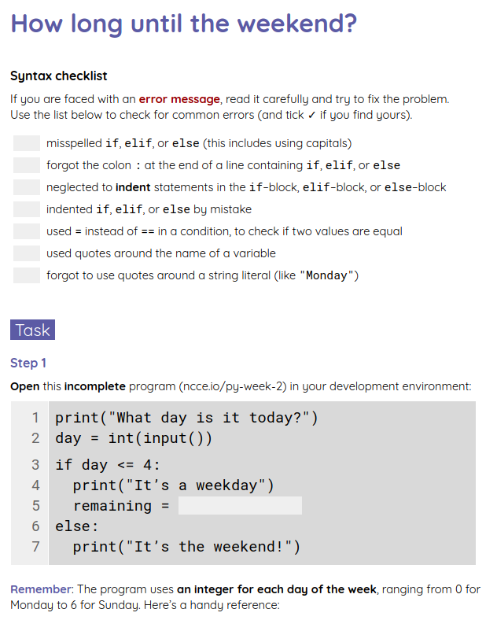
Activity 2
How long until the weekend?
Complete the task in your worksheet to extend your current program even further.

Slide 13
Activity 2
How long until the weekend? Solution
1
2
3
4
5
6
7
8
print("What day is it today?")
day = int(input())
if day < 4:
print("It’s a weekday")
remaining = 5 - day
print(remaining, "days until the weekend")
else:
print("It’s the weekend!")
Remaining days .
(steps 2-3).

Slide 14
Activity 2
How long until the weekend? Solution
1
2
3
4
5
6
7
8
9
10
11
print("What day is it today?")
day = int(input())
if day < 4:
print("It’s a weekday")
remaining = 5 - day
print(remaining, "days until the weekend")
elif day == 4:
print("It’s Friday")
print("Just a day left until the weekend")
else:
print("It’s the weekend!")
Handle Friday as a special case .
(step 4).

Slide 15
Activity 2
How long until the weekend? Solution
1
2
3
4
5
6
7
8
9
10
11
from datetime import datetime
day = datetime.now().weekday()
if day < 4:
print("It’s a weekday")
remaining = 5 - day
print(remaining, "days until the weekend")
elif day == 4:
print("It’s Friday")
print("Just a day left until the weekend")
else:
print("It’s the weekend!")
Retrieve the current day of the week .
(explorer task)

Slide 16
Activity 3
A list of names
1
2
3
4
days = ["Monday", "Tuesday",
"Wednesday", "Thursday",
"Friday", "Saturday",
"Sunday"]
The names for the days of the week can be stored in a list .
Syntax: A comma-separated list of values (items), in square brackets.
In this example, the list items are string literals (i.e. pieces of text), so they need to be in quotation marks.

Slide 17
Activity 3
A list of names
1
2
3
4
days = ["Monday", "Tuesday",
"Wednesday", "Thursday",
"Friday", "Saturday",
"Sunday"]
A list is a kind of data structure .
Data structures are organised collections of data.
In the case of lists, data is organised in a sequence, with each item having a unique index, denoting its position in the list.

Slide 18
Activity 3
A list of names
1
2
3
4
days = ["Monday", "Tuesday",
"Wednesday", "Thursday",
"Friday", "Saturday",
"Sunday"]
days
0 | "Monday"
1 | "Tuesday"
2 | "Wednesday"
3 | "Thursday"
4 | "Friday"
5 | "Saturday"
6 | "Sunday"
When the program is executed, this is what the list will look like in memory.

Slide 19

Activity 3
A list of names
1
2
3
4
days = ["Monday", "Tuesday",
"Wednesday", "Thursday",
"Friday", "Saturday",
"Sunday"]
days
0 | "Monday"
1 | "Tuesday"
2 | "Wednesday"
3 | "Thursday"
4 | "Friday"
5 | "Saturday"
6 | "Sunday"
Note: List item numbering starts from 0 (zero-based).
Each item has a unique index, denoting its position in the list.

Slide 20
Activity 3
A number for a name
1
2
3
4
5
days = ["Monday", "Tuesday",
"Wednesday", "Thursday",
"Friday", "Saturday",
"Sunday"]
print(days[0])
days
0 | "Monday"
1 | "Tuesday"
2 | "Wednesday"
3 | "Thursday"
4 | "Friday"
5 | "Saturday"
6 | "Sunday"
When this program is executed, what will be displayed on the screen?
Answer: Monday

Slide 21
Activity 3
A number for a name
1
2
3
4
5
days = ["Monday", "Tuesday",
"Wednesday", "Thursday",
"Friday", "Saturday",
"Sunday"]
print(days[1])
days
0 | "Monday"
1 | "Tuesday"
2 | "Wednesday"
3 | "Thursday"
4 | "Friday"
5 | "Saturday"
6 | "Sunday"
When this program is executed, what will be displayed on the screen?
Answer: Tuesday

Slide 22
Activity 3
A number for a name
1
2
3
4
5
days = ["Monday", "Tuesday",
"Wednesday", "Thursday",
"Friday", "Saturday",
"Sunday"]
print(days[4])
days
0 | "Monday"
1 | "Tuesday"
2 | "Wednesday"
3 | "Thursday"
4 | "Friday"
5 | "Saturday"
6 | "Sunday"
When this program is executed, what will be displayed on the screen?
Answer: Friday

Slide 23
Activity 3
A number for a name
1
2
3
4
5
days = ["Monday", "Tuesday",
"Wednesday", "Thursday",
"Friday", "Saturday",
"Sunday"]
print(days[7])
days
0 | "Monday"
1 | "Tuesday"
2 | "Wednesday"
3 | "Thursday"
4 | "Friday"
5 | "Saturday"
6 | "Sunday"
When this program is executed, what will be displayed on the screen?
Answer: An IndexError will occur.

Slide 24
Activity 3
A number for a name
1
2
3
4
5
6
days = ["Monday", "Tuesday",
"Wednesday", "Thursday",
"Friday", "Saturday",
"Sunday"]
day = 3
print(days[day])
days
0 | "Monday"
1 | "Tuesday"
2 | "Wednesday"
3 | "Thursday"
4 | "Friday"
5 | "Saturday"
6 | "Sunday"
day
3
Expressions can be used to access item lists (as long as they evaluate to an integer).

Slide 25
Activity 3
A number for a name
1
2
3
4
5
6
days = ["Monday", "Tuesday",
"Wednesday", "Thursday",
"Friday", "Saturday",
"Sunday"]
day = 3
print(days[day])
days
0 | "Monday"
1 | "Tuesday"
2 | "Wednesday"
3 | "Thursday"
4 | "Friday"
5 | "Saturday"
6 | "Sunday"
day
3
3
When this program is executed, what will be displayed on the screen?
Answer: Thursday

Slide 26
Activity 3
A number for a name
1
2
3
4
5
6
days = ["Monday", "Tuesday",
"Wednesday", "Thursday",
"Friday", "Saturday",
"Sunday"]
day = 3
print(days[day-1])
days
0 | "Monday"
1 | "Tuesday"
2 | "Wednesday"
3 | "Thursday"
4 | "Friday"
5 | "Saturday"
6 | "Sunday"
day
3
2
When this program is executed, what will be displayed on the screen?
Answer: Wednesday

Slide 27
Activity 3
A number for a name
1
2
3
4
days = ["Monday", "Tuesday",
"Wednesday", "Thursday",
"Friday", "Saturday",
"Sunday"]
Examine an extended version (ncce.io/py-week-5) of the previous program, which incorporates the list of days.

Slide 28
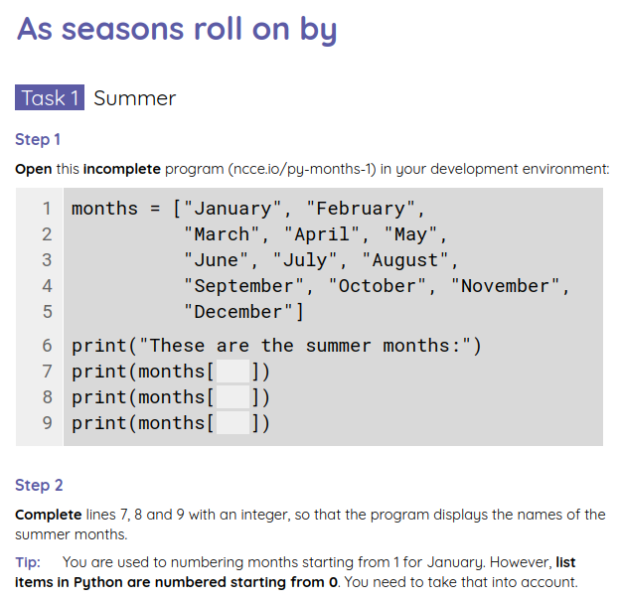
Activity 4
As seasons roll on by
Complete the tasks in your worksheet to explore lists and practise some more with selection.

Slide 29
Activity 4
As seasons roll on by: Solutions
1
2
3
4
5
6
7
8
9
months = ["January", "February",
"March", "April", "May",
"June", "July", "August",
"September", "October", "November",
"December"]
print("These are the summer months:")
print(months[5])
print(months[6])
print(months[7])
June has an index of 5.
July has an index of 6.
August has an index of 7.
All indices are shifted by 1, compared to the common numbering of months, because list item numbering is zero-based.

Slide 30
Activity 4
As seasons roll on by: Solutions
1
2
3
4
5
6
7
8
months = ["January", "February",
"March", "April", "May",
"June", "July", "August",
"September", "October", "November",
"December"]
print("What month is it? (1-12)")
month = int(input())
print("It is", months[month-1])
The month (provided by the user) is reduced by 1, before it is used as an index, because list item numbering is zero-based.

Slide 31
Activity 4
As seasons roll on by: Solutions
1
2
3
4
5
6
7
8
9
10
11
12
seasons = ["Winter", "Spring", "Summer", "Autumn"]
print("What month is it? (1-12)")
month = int(input())
if month <= 2 or month == 12:
season = 0
elif month <= 5:
season = 1
elif month <= 8:
season = 2
else:
season = 3
print("It is", seasons[season])
The condition that checks if this is a winter month is more complex, because the numbering for winter months is not consecutive.

Slide 32

Plenary
Lists of what?
In this lesson, you used lists that stored the names of days, months, and seasons.
What else do you think a program could store in a list?

Slide 33
Summary
In this lesson, you...
In the next lesson, you will...
Brushed up on your Python skills
Used selection (if-elif-else statements) to control the flow of program execution
Created lists and accessed their items
Perform operations on lists

Slide 34
Lesson Part 2: Playlist
Break Time
Notes:
Last updated: 12-05-2021
Resources are updated regularly — the latest version is available at: ncce.io/tcc.
This resource is licensed under the Open Government Licence, version 3. For more information on this licence, see ncce.io/ogl.

Slide 35
Starter activity
Walkthrough
1
2
3
4
5
6
7
planets = ["Mercury", "Venus",
"Earth", "Mars",
"Jupiter", "Saturn",
"Uranus", "Neptune"]
position = 3
object = planets[position]
print(object)
Question .
What will be displayed on the screen when this program is executed?
Venus
Earth
Mars
Jupiter

Slide 36
Starter activity
Walkthrough: Answer
1
2
3
4
5
6
7
planets = ["Mercury", "Venus",
"Earth", "Mars",
"Jupiter", "Saturn",
"Uranus", "Neptune"]
position = 3
object = planets[position]
print(object)
planets
When the program is executed, this is what the list of planets will look like in memory.
0 | "Mercury"
1 | "Venus"
2 | "Earth"
3 | "Mars"
4 | "Jupiter"
5 | "Saturn"
6 | "Uranus"
7 | "Neptune"
Item numbering in lists begins with 0.
3

Slide 37
Starter activity
Walkthrough: Answer
1
2
3
4
5
6
7
planets = ["Mercury", "Venus",
"Earth", "Mars",
"Jupiter", "Saturn",
"Uranus", "Neptune"]
position = 3
object = planets[position]
print(object)
Question .
What will be displayed on the screen, when this program is executed?
Venus
Earth
Mars
Jupiter
▹

Slide 38
Objectives
In this lesson, you will...
Perform operations on lists
Brush up on your Python skills (mainly selection)

Slide 39
Activity 1
The index of an item
1
2
3
4
5
6
planets = ["Mercury", "Venus",
"Earth", "Mars",
"Jupiter", "Saturn",
"Uranus", "Neptune"]
position = planets.index("Venus")
print(position)
Question .
What do you think will be displayed on the screen when this program is executed?

Slide 40
Activity 1
The index of an item
1
2
3
4
5
6
planets = ["Mercury", "Venus",
"Earth", "Mars",
"Jupiter", "Saturn",
"Uranus", "Neptune"]
position = planets.index("Venus")
print(position)
planets
When the program is executed, this is what the list of planets will look like in memory.
0 | "Mercury"
1 | "Venus"
2 | "Earth"
3 | "Mars"
4 | "Jupiter"
5 | "Saturn"
6 | "Uranus"
7 | "Neptune"
Item numbering in lists begins with 0.

Slide 41
Activity 1
The index of an item
1
2
3
4
5
6
planets = ["Mercury", "Venus",
"Earth", "Mars",
"Jupiter", "Saturn",
"Uranus", "Neptune"]
position = planets.index("Venus")
print(position)
Question .
What do you think will be displayed on the screen when this program is executed?
Answer The number 1 will be displayed.
This is the index of the value "Venus" in the list of planets.

Slide 42
Activity 1
Operations on lists
There are many operations you can perform on lists and their items.
Some examples
list.append(item) add item at end of list
list.insert(index, item) add item at index
list.pop(index) remove item at index
list.remove(item) remove item
list.index(item) search for index of item
list.count(item) get occurrences of item
list.reverse() reverse list
list.sort() sort list
numbers.append(42)
cities.insert(2, "Oslo")
last = values.pop()
countries.remove("Japan")
where = planets.index("Mars")
nb_the = words.count("the")
values.reverse()
names.sort()

Slide 43
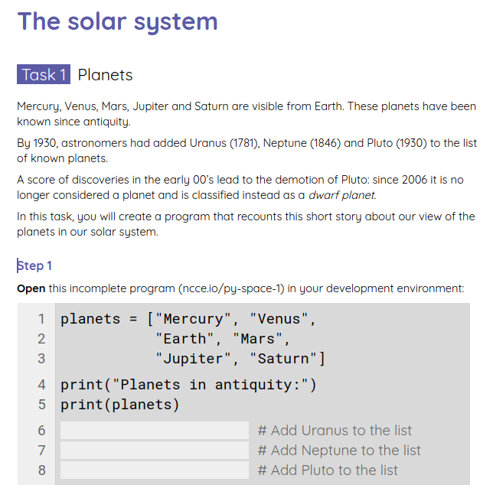
Activity 2
The solar system
Complete the tasks on your worksheet to see how our view of the solar system has evolved over time.
To perform the tasks, you will need to perform operations on lists.

Slide 44

Activity 2
The solar system: Solutions
1
2
3
4
5
6
7
8
9
10
planets = ["Mercury", "Venus",
"Earth", "Mars",
"Jupiter", "Saturn"]
print("Planets in antiquity:")
print(planets)
Add Uranus to the list of planets
Add Neptune to the list of planets
Add Pluto to the list of planets
print("Planets by 1930:")
print(planets)
Uranus (1781), Neptune (1846), and Pluto (1930) were discovered later.
Challenge .
Add these three planets to the list of planets, one at a time.

Slide 45
Activity 2
The solar system: Solutions
1
2
3
4
5
6
7
8
9
10
planets = ["Mercury", "Venus",
"Earth", "Mars",
"Jupiter", "Saturn"]
print("Planets in antiquity:")
print(planets)
planets.append("Uranus")
planets.append("Neptune")
planets.append("Pluto")
print("Planets by 1930:")
print(planets)
Uranus (1781), Neptune (1846), and Pluto (1930) were discovered later.
Challenge .
Add these three planets to the list of planets, one at a time.

Slide 46
Activity 2
The solar system: Walkthrough
1
2
3
4
5
6
7
8
9
10
planets = ["Mercury", "Venus",
"Earth", "Mars",
"Jupiter", "Saturn"]
print("Planets in antiquity:")
print(planets)
planets.append("Uranus")
planets.append("Neptune")
planets.append("Pluto")
print("Planets by 1930:")
print(planets)
planets
0 | "Mercury"
1 | "Venus"
2 | "Earth"
3 | "Mars"
4 | "Jupiter"
5 | "Saturn"

Slide 47
Activity 2
The solar system: Walkthrough
1
2
3
4
5
6
7
8
9
10
planets = ["Mercury", "Venus",
"Earth", "Mars",
"Jupiter", "Saturn"]
print("Planets in antiquity:")
print(planets)
planets.append("Uranus")
planets.append("Neptune")
planets.append("Pluto")
print("Planets by 1930:")
print(planets)
planets
0 | "Mercury"
1 | "Venus"
2 | "Earth"
3 | "Mars"
4 | "Jupiter"
5 | "Saturn"
6 | "Uranus"

Slide 48
Activity 2
The solar system: Walkthrough
1
2
3
4
5
6
7
8
9
10
planets = ["Mercury", "Venus",
"Earth", "Mars",
"Jupiter", "Saturn"]
print("Planets in antiquity:")
print(planets)
planets.append("Uranus")
planets.append("Neptune")
planets.append("Pluto")
print("Planets by 1930:")
print(planets)
planets
0 | "Mercury"
1 | "Venus"
2 | "Earth"
3 | "Mars"
4 | "Jupiter"
5 | "Saturn"
6 | "Uranus"
7 | "Neptune"
8 | "Pluto"

Slide 49
Activity 2
The solar system: Solutions
9
10
11
12
13
print("Planets by 1930:")
print(planets)
Remove Pluto from the list
print("Planets after 2006:")
print(planets)
Poor Pluto was demoted in 2006: it was removed from the list of planets and classified as a dwarf planet.
Challenge .
Continue with your existing program.
Remove Pluto from the planets list.

Slide 50
Activity 2
The solar system: Solutions
9
10
11
12
13
print("Planets by 1930:")
print(planets)
planets.remove("Pluto")
print("Planets after 2006:")
print(planets)
Poor Pluto was demoted in 2006: it was removed from the list of planets and classified as a dwarf planet.
Challenge .
Continue with your existing program.
Remove Pluto from the planets list.

Slide 51
Activity 2
The solar system: Walkthrough
9
10
11
12
13
print("Planets by 1930:")
print(planets)
planets.remove("Pluto")
print("Planets after 2006:")
print(planets)
planets
0 | "Mercury"
1 | "Venus"
2 | "Earth"
3 | "Mars"
4 | "Jupiter"
5 | "Saturn"
6 | "Uranus"
7 | "Neptune"
8 | "Pluto"

Slide 52
Activity 2
The solar system: Walkthrough
9
10
11
12
13
print("Planets by 1930:")
print(planets)
planets.remove("Pluto")
print("Planets after 2006:")
print(planets)
planets
0 | "Mercury"
1 | "Venus"
2 | "Earth"
3 | "Mars"
4 | "Jupiter"
5 | "Saturn"
6 | "Uranus"
7 | "Neptune"

Slide 53
Activity 2
The solar system: Solutions
1
4
5
dwarves =
print("Dwarf planets:")
print(dwarves)
In 2006, some sub-planetary objects were classified as dwarf planets.
Challenge .
Create a list containing names of dwarf planets: Ceres, Ataecina, Eris, and Makemake.
Create the list of dwarf
planets

Slide 54
Activity 2
The solar system: Solutions
1
4
5
dwarves = ["Ceres", "Ataecina",
"Eris", "Makemake"]
print("Dwarf planets:")
print(dwarves)
In 2006, some sub-planetary objects were classified as dwarf planets.
Challenge .
Create a list containing names of dwarf planets: Ceres, Ataecina, Eris, and Makemake.

Slide 55
Activity 2
The solar system: Solutions
1
2
4
5
dwarves = ["Ceres", "Ataecina",
"Eris", "Makemake"]
Change second list item to Haumea
print("Dwarf planets:")
print(dwarves)
In 2008, Haumea was recognised as the official name of Ataecina.
Challenge .
Continue with your existing program. Modify the second item of the list.
Assign the value "Haumea" to it.

Slide 56
Activity 2
The solar system: Solutions
1
2
4
5
dwarves = ["Ceres", "Ataecina",
"Eris", "Makemake"]
dwarves[1] = "Haumea"
print("Dwarf planets:")
print(dwarves)
In 2008, Haumea was recognised as the official name of Ataecina.
Challenge .
Continue with your existing program. Modify the second item of the list.
Assign the value "Haumea" to it.

Slide 57
Activity 2
The solar system: Walkthrough
1
2
4
5
dwarves = ["Ceres", "Ataecina",
"Eris", "Makemake"]
dwarves[1] = "Haumea"
print("Dwarf planets:")
print(dwarves)
dwarves
0 | "Ceres"
1 | "Ataecina"
2 | "Eris"
3 | "Makemake"

Slide 58
Activity 2
The solar system: Walkthrough
1
2
4
5
dwarves = ["Ceres", "Ataecina",
"Eris", "Makemake"]
dwarves[1] = "Haumea"
print("Dwarf planets:")
print(dwarves)
dwarves
0 | "Ceres"
1 | "Haumea"
2 | "Eris"
3 | "Makemake"

Slide 59
Activity 2
The solar system: Solutions
1
2
3
4
5
dwarves = ["Ceres", "Ataecina",
"Eris", "Makemake"]
dwarves[1] = "Haumea"
Add Pluto as 2nd item
print("Dwarf planets:")
print(dwarves)
Pluto should also be added to the list. Chronologically, it was the second to be discovered.
Challenge .
Continue with your existing program. Insert Pluto as the second item in the list.

Slide 60
Activity 2
The solar system: Solutions
1
2
3
4
5
dwarves = ["Ceres", "Ataecina",
"Eris", "Makemake"]
dwarves[1] = "Haumea"
dwarves.insert(1, "Pluto")
print("Dwarf planets:")
print(dwarves)
Pluto should also be added to the list. Chronologically, it was the second to be discovered.
Challenge .
Continue with your existing program. Insert Pluto as the second item in the list.

Slide 61
Activity 2
The solar system: Walkthrough
1
2
3
4
5
dwarves = ["Ceres", "Ataecina",
"Eris", "Makemake"]
dwarves[1] = "Haumea"
dwarves.insert(1, "Pluto")
print("Dwarf planets:")
print(dwarves)
dwarves
0 | "Ceres"
1 | "Haumea"
2 | "Eris"
3 | "Makemake"

Slide 62
Activity 2
The solar system: Walkthrough
1
2
3
4
5
dwarves = ["Ceres", "Ataecina",
"Eris", "Makemake"]
dwarves[1] = "Haumea"
dwarves.insert(1, "Pluto")
print("Dwarf planets:")
print(dwarves)
dwarves
0 | "Ceres"
1 | "Pluto"
2 | "Haumea"
3 | "Eris"
4 | "Makemake"

Slide 63
Activity 3
Dice battle game
Roll The attacker rolls three dice. The defender rolls two.
Sort Each player’s rolls are sorted in descending order (highest first).
Check Compare the players’ highest roll: lower loses a point.
Compare the players’ second highest roll: lower loses a point.
Ties are won by the defender.

Slide 64





Activity 3
Dice battle game: Example 1
Roll The attacker rolls three dice. The defender rolls two.
Sort Each player’s rolls are sorted in descending order (highest first).
Check Compare the players’ highest roll: lower loses a point.
Compare the players’ second highest roll: lower loses a point.
Ties are won by the defender.
Example: Roll

Slide 65
Activity 3
Dice battle game: Example 1
Roll The attacker rolls three dice. The defender rolls two.
Sort Each player’s rolls are sorted in descending order (highest first).
Check Compare the players’ highest roll: lower loses a point.
Compare the players’ second highest roll: lower loses a point.
Ties are won by the defender.
Example: Sort

Slide 66
Activity 3
Dice battle game: Example 1
Roll The attacker rolls three dice. The defender rolls two.
Sort Each player’s rolls are sorted in descending order (highest first).
Check Compare the players’ highest roll: lower loses a point.
Compare the players’ second highest roll: lower loses a point.
Ties are won by the defender.
Example: Check
-1
-1

Slide 67




Activity 3
Dice battle game: Example 2
Roll The attacker rolls three dice. The defender rolls two.
Sort Each player’s rolls are sorted in descending order (highest first).
Check Compare the players’ highest roll: lower loses a point.
Compare the players’ second highest roll: lower loses a point.
Ties are won by the defender.
Example: Roll

Slide 68
Activity 3
Dice battle game: Example 2
Roll The attacker rolls three dice. The defender rolls two.
Sort Each player’s rolls are sorted in descending order (highest first).
Check Compare the players’ highest roll: lower loses a point.
Compare the players’ second highest roll: lower loses a point.
Ties are won by the defender.
Example: Sort

Slide 69
Activity 3
Dice battle game: Example 2
Roll The attacker rolls three dice. The defender rolls two.
Sort Each player’s rolls are sorted in descending order (highest first).
Check Compare the players’ highest roll: lower loses a point.
Compare the players’ second highest roll: lower loses a point.
Ties are won by the defender.
Example: Check
-1
-1

Slide 70
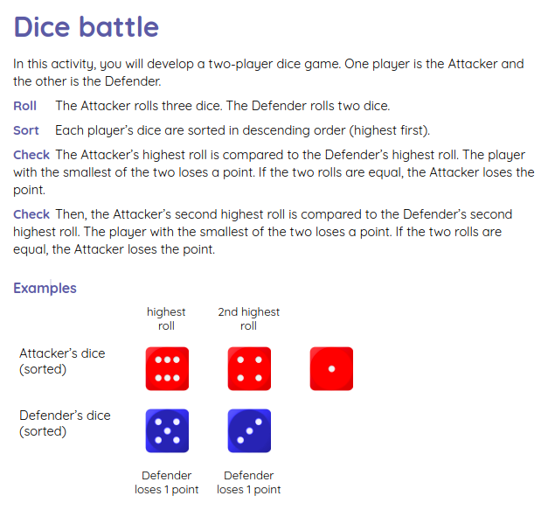
Activity 3
Dice battle game
Create a program for this game by completing the task on your worksheet.

Slide 71
Activity 3
Dice battle game: Solutions
4
5
6
7
8
9
10
11
12
13
attacker = dicerolls(3)
defender = dicerolls(2)
print("Players’ rolls")
print("Attacker:", attacker)
print("Defender:", defender)
Sort the Attacker’s dice
Sort the Defender’s dice
print("Sorted")
print("Attacker:", attacker)
print("Defender:", defender)

Slide 72
Activity 3
Dice battle game: Solutions
4
5
6
7
8
9
10
11
12
13
attacker = dicerolls(3)
defender = dicerolls(2)
print("Players’ rolls")
print("Attacker:", attacker)
print("Defender:", defender)
attacker.sort(reverse=True)
defender.sort(reverse=True)
print("Sorted")
print("Attacker:", attacker)
print("Defender:", defender)
You can also sort in ascending order and then reverse.

Slide 73
Activity 3
Dice battle game: Solutions
9
10
11
12
13
14
15
16
17
attacker.sort(reverse=True)
defender.sort(reverse=True)
print("Sorted")
print("Attacker:", attacker)
print("Defender:", defender)
if attacker[0] > defender[0]:
defender_points = defender_points - 1
else:
attacker_points = attacker_points - 1
Compare the two players’ highest rolls. The rolls have been sorted, so you know that the highest rolls are first.

Slide 74
Activity 3
Dice battle game: Solutions
9
10
11
12
13
14
15
16
17
18
19
20
21
attacker.sort(reverse=True)
defender.sort(reverse=True)
print("Sorted")
print("Attacker:", attacker)
print("Defender:", defender)
if attacker[0] > defender[0]:
defender_points = defender_points - 1
else:
attacker_points = attacker_points - 1
if attacker[1] > defender[1]:
defender_points = defender_points - 1
else:
attacker_points = attacker_points - 1
Compare the two players’ second highest rolls.

Slide 75
Activity 4
Measuring length
The built-in len function returns the length (number of items) of a list.
Syntax len(list)
Examples
nb_dwarves = len(dwarves)
if seats > len(guests):
print("Insufficient seats")
while len(rolls) < 100:
dice = randint(1,6)
rolls.append(dice)

Slide 76
Activity 4
Measuring length
1
2
3
4
5
6
planets = ["Mercury", "Venus",
"Earth", "Mars",
"Jupiter", "Saturn",
"Uranus", "Neptune"]
length = len(planets)
print(length)
Question .
What will be displayed on the screen, when this program is executed?
Answer 8, which is the number of items in the list of planets.

Slide 77
Activity 4
List membership
The in operator checks if a value is equal to any item in a list.
Expressions formed with in evaluate to either True or False.
Syntax item in list
Examples
if "chips" in supplies:
supplies.remove("chips")
if not word in sensored:
print("You can use", word)
invited = myname in guests

Slide 78
Activity 4
List membership
1
2
3
4
5
6
planets = ["Mercury", "Venus",
"Earth", "Mars",
"Jupiter", "Saturn",
"Uranus", "Neptune"]
status = "Pluto" in planets
print(status)
Question .
What will be displayed on the screen, when this program is executed?
Answer False, which is the value of the expression "Pluto" in planets. There is no item equal to "Pluto" in the list of planets.

Slide 79

Activity 4
Literature
1
2
from textfile import words
wordlist = words('dracula.txt')
This code retrieves the entire text of Bram Stoker’s Dracula and stores it as a list of words (wordlist).
Note The textfile module and the words function are not standard Python components.

Slide 80
Activity 4
Literature
1
2
3
from textfile import words
wordlist = words('dracula.txt')
length = len(wordlist)
Question .
What does line 3 compute?
Answer How many words there are in the book.

Slide 81
Activity 4
Literature
1
2
3
4
5
from textfile import words
wordlist = words('dracula.txt')
length = len(wordlist)
print(length, "words in Dracula")
contains = "vampire" in wordlist
Question .
What does line 5 compute?
Answer Whether or not "vampire" appears in the book (True or False)
Question .
How can you modify the program to compute the number of times that "vampire" appears in the book?

Slide 82
Activity 4
Literature
1
2
3
4
5
6
from textfile import words
wordlist = words('dracula.txt')
length = len(wordlist)
print(length, "words in Dracula")
times = wordlist.count('vampire')
print(times)
How many times do you think that the word "vampire" appears in the book?
Run the program to see for yourselves (ncce.io/py-books-1)

Slide 83
Recap
Name some of the operations that can be performed on lists.
Reversing
Sorting
Adding items
(appending, inserting)
Searching
membership,
finding the index of an item,
counting occurrences
Deleting items
(popping, removing)

Slide 84
Summary
In this lesson, you...
Next lesson, you will...
Performed operations on lists
Brushed up on your Python skills (mainly selection)
Use iteration (while statements) to control the flow of program execution
Practise using common operations on lists
Perform operations on strings

